Slide 1

Automated Control system for a Small-scale Green House
200313P
200314U
200315A

Slide 2
Light
Intensity
Make a way to reduce Light effect
Make a way to reduce temperature
Temperature
Make a way to Dryness
Moisture

Slide 3

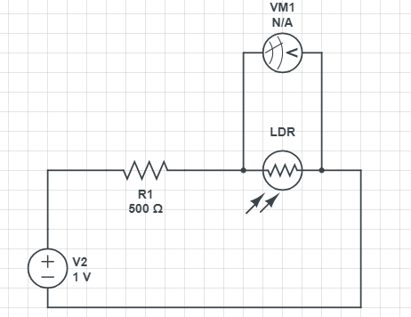
We built a Light sensor using a LDR
Measured the variation of Voltage across the LDR using a Multimeter with the Light intensity using a LUX meter
Plot the variation and we get a power Equation and we calibrate it
We get the equation as follows

Slide 4
Lux | V
270 | 3.52
120 | 3.93
1.3 | 4.96
185 | 3.76
90 | 4
440 | 2.93
600 | 2.63
700 | 2.5
1009 | 2.3
1300 | 2.16
2900 | 1.64
4020 | 1.47
105000 | 0.41
23067 | 0.84
17000 | 1.45
22000 | 0.76
7000 | 1.14
12500 | 1.13
40500 | 0.57
80000 | 0.51
60000 | 0.69
50000 | 0.54
40000 | 0.63
20000 | 0.83

Slide 6
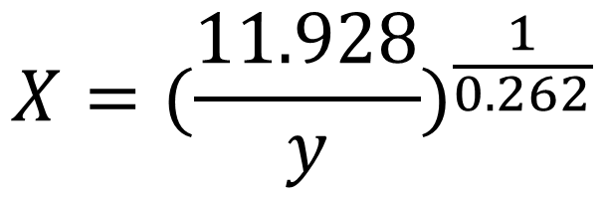
y = 11.928 x ^{-0.262}
^{X=Light intensity}
^{Y=Voltage across the LDR}
Sensor formula is
$$X={(\frac{11.928}{y})}^{\frac{1}{0.262}}$$

Slide 7

In the controlling part of Light we use a Logic Gate to connectivity
Light intensity is high = L (1)
Light intensity is Low= L (0)
Ultra sonic 1 detect the screen =A(1)
Ultra sonic 1 detect the screen =A(0)
Ultra sonic 2 detect the screen =B(1)
Ultra sonic 2 detect the screen =B(0)

Slide 8
L | A | B | In 1 | In2
0 | 0 | 0 | 0 | 0
0 | 0 | 1
0 | 1 | 0 | 1 | 0
0 | 1 | 1 | 1 | 0
1 | 0 | 0 | 0 | 1
1 | 0 | 1
1 | 1 | 0 | 0 | 1
1 | 1 | 1 | 0 | 0
Off
reverse
Hypothetical cases
Forward
Off

